Slide 1

#azuresql
#sqlserver
PREVIEW
Migrate SQL Server to Azure
Workshop
Bob Ward
Anna Hoffman
Buck Woody
Bradley Ball

Slide 2
Welcome to the Migrate SQL Server to Azure Workshop!
This series of modules will help you learn how to migrate SQL Server to Azure in a way you can apply what you learn to your own projects.
Tips!
It's interactive, so you can ask questions. Just pop them in the Q&A window.
We will do a lot of demos!
We will have breaks
Notes:
Bob

Slide 3



Migrate SQL Server to Azure Workshop
PREVIEW
Module 1 Migrate SQL Server to Azure Fundamentals
Module 5
Migrate to Azure SQL Managed Instance
Module 2 Assess SQL Server
Module 6
Optimize and manage
Azure SQL Managed Instance
Module 3 Migrate to Azure Virtual Machine
Module 4
Optimize and manage SQL Server
in Azure Virtual Machine
Module 7
Migrate from Azure Virtual Machine
to Managed Instance
aka.ms/migratesqltoazureworkshop
aka.ms/datamigration
aka.ms/sqlworkshops
Notes:
Bob to mention Azure DB is not part of our workshop and why

Slide 4











Migration scenarios
Discover
Azure Migrate
Assess
Data Migration
Assistant
Migrate to Azure SQL Managed Instance
SQL Server 2016
SQL Server 2019
Migrate to Azure Virtual Machine
Offline migration
Using backup/restore
Online migration
using ADS
Azure Data Studio
Online migration
Using ADS and
Log Replay Service (LRS)
Optimize and manage
Optimize and manage

Slide 5
Basic migration - SQL Server 2016
Resource Requirements
Installed on Virtual machine with 16 vCores and 64Gb RAM
Database is ~30Gb data and ~2Gb transaction log
Data and log files are stored on the same drive
Desired storage growth is 1TB for data and 500Gb for transaction log
Tempdb split into 8 files on the OS drive
Backups are stored on different storage
SQL Server 2016
Standalone instance Standard Edition on Windows Server 2016
Application is based on TPC-H
ISV application requires SQL Server 2016
Can afford downtime to migrate to Azure
SQL Server requirements
SQL logins for authentication
SQL Agent jobs for auto backups and update stats
Use Query Store and DMVs to monitor performance
Use SSMS to query and monitor SQL Server
DBAs desire access to the ERRORLOG for monitoring and troubleshooting purposes

Slide 6
Advanced migration - SQL Server 2019
Resource Requirements
Installed on Virtual machine with 32 vCores and 256Gb RAM
Database is ~50Gb data and ~12Gb transaction log
Data and log files are stored on different drives
Desired storage growth is 1.5TB for data and 500Gb for tlog
Tempdb split into 12 files on separate storage
Backups are stored on different storage
SQL Server 2019
SQL Server Enterprise Edition running on Windows Server 2019 in a domain
Application based on TPC-C
Database deployed in an Availability Group with 1 sync secondary replica
ISV application will support PaaS
Need online migration
Desire benefits of Azure managed services
SQL Server requirements
Windows logins for authentication
SQL Agent jobs for auto backups, checkdb, and reorg indexes
Use Query Store and DMVs to monitor performance
Use SSMS to query and monitor SQL Server
Extended events sessions with file target
DBAs desire access to the ERRORLOG for monitoring and troubleshooting purposes
Desire to implement SQL Server Machine Learning Services

Slide 7
Migrate SQL Server to Azure Fundamentals
Module 1
Azure Fundamentals
Azure Migration lifecycle
Azure Migration Tools
Summary

Slide 8
Azure Ecosystem
Azure Accounts and Subscriptions
Azure Portal
Azure Marketplace
Azure APIs and CLIs
Azure Resource Manager (ARM)
Azure Monitor
Azure Regions and Datacenters
Azure SLA, Compliance, and Trust

Slide 9


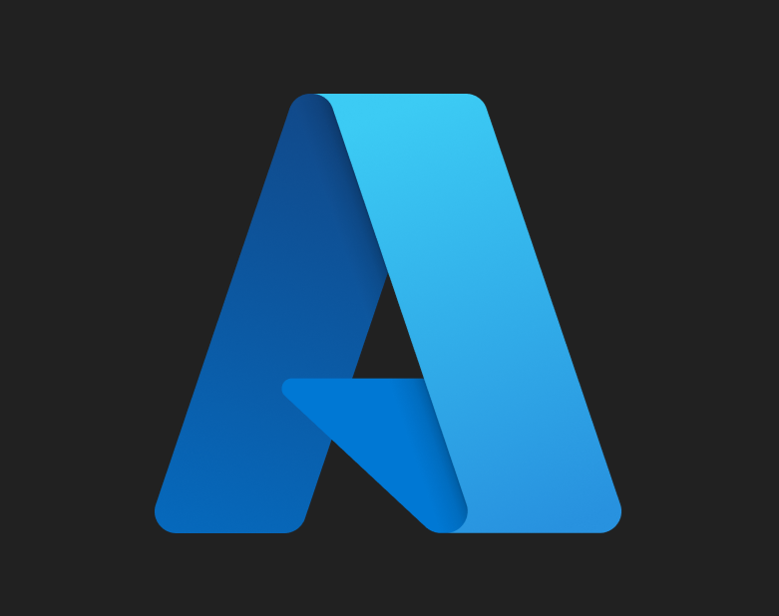


Azure Trust
aka.ms/azuretrust
Global infrastructure security
Secrets, keys, and data protection
Identity management
Monitoring, auditing, and threat protection
Multi-layered
security
Intelligence
Compliance
Trillions of daily security signals
Machine Learning
Cyber Defense Operations Center (CDOC)
90 compliance offerings
US Government and global regions
Industry specific
Azure policy
Privacy
You control your data
Transparency
Data secured at rest and in transit
Defending your privacy

Slide 10



zure SQL
The family of SQL cloud databases
SQL Server on Azure Virtual Machines
Azure SQL Managed Instance
Azure SQL Database with Hyperscale
Best for modernizing existing apps and high compatibility with SQL Server
Best for supporting modern cloud apps with Pre-provisioned or serverless compute and Hyperscale storage
Best for lift and shift and/or workloads requiring OS-level access
Infrastructure-as-a-Service
Platform-as-a-Service
Familiarity
Tools
Flexibility
Notes:
Family of SQL cloud databases (SQL portfolio)
What we have for you
IaaS – SQL is running in your own VM where you have full control. Yet, cost of infrastructure management is minimized. Ideal for apps that need full level of control and stack customization
PaaS – we have two choices
MI is a fully managed SQL engine/ Unlike VM – stack is managed by MSFT.
Flexibility: programming language, dev tools and drivers and even operating system

Slide 11
Demo Azure SQL in the marketplace
Notes:
Show how to choose from the Marketplace
Show how to see existing Azure sql services in the portal

Slide 12

SQL Server on Azure Virtual Machines
Marketplace pre-installed SQL Server on Windows or Linux
Install your own SQL Server
Lift and Shift with Azure Migrate (Azure Migrate)
Deployment Choices
Unlock Licensing and Edition Flexibility
Automated Backups and Security Updates
Manage VMs through Azure SQL in portal
SQL Assessment
SQL IaaS Agent Extension
Memory and I/O optimized sizes for best performance
Data and log on Premium Storage Managed Disks
Support maximum size of managed disks * max # disks
Azure Blob Read Caching for data disks
Tempdb on local SSD
Ultra disks for extremely low latency needs
Backups can go on managed disks, Azure Blob Storage, or Azure Premium File Shares
Sizes and Storage Performance
Networking and Security
Virtual Networks to integrate with on-premises
Microsoft Defender for SQL
Azure VM built-in HA
Azure Storage built-in redundancy
Azure Backup and Automated backups
Failover Cluster Instance with Azure Premium File Share
Always On Availability Groups with Cloud Witness
Hybrid Availability Group Secondary replicas
HADR on RedHat Linux with HA add-on
HADR
Start here for SQL Server on Linux in Azure Virtual Machine
Notes:
Today the limit (based on VM size) for managed disk capacity is 64 disk * 32TB = 2048 TB
Maximum size of a single SQL Server database is 524,272 terabytes
Max size of a single db file is 16 TB

Slide 13

Azure Virtual Machine Sizes
aka.ms/azurevmsizes
aka.ms/SQLIaaSSizing
The alphabet of virtual machine choices
Try the VM selector tool
Follow our blogs
Generation
Storage choices
vCores
Memory
IOPS
I/O throughput
Network bandwidth
Caching
Processor type
General Purpose
Memory Optimized
Storage Optimized
D series
E and M series
L Series
Works for many workloads
Versions
DC = Intel SGX
Intel and AMD options
Best for SQL Server production
Highest memory to core ratio
Versions
Intel and AMD options
Constrained vCPUs = save licensing M series = up to 416 vCPU
New Eb series = I/O to core ratio
Highest I/O throughput
AMD EPYC
NVMe SSD

Slide 14

Azure SQL Managed Instance
Pre-installed SQL Server with abstraction from OS and Infrastructure
It is the same engine but versionless
Almost 100% compatible T-SQL language
The instance features you need such as SQL Server Agent
Fully Managed Service = SQL + cloud to automate and integrate
Built-in High Availability
Azure Monitor SQL Insights
Automated backup system
Azure Active Directory
Private Virtual Network
Automatic updates
Declarative deployment model
The power of the cloud

Slide 15
Service tiers – Deployment options
Hardware options
General purpose
Business critical
Standard
(Gen5) Intel Broadwell CPU
80 vCores/5.1Gb per vCore
Most business workloads
Workloads that require low latency, fast recovery, and a readable secondary
Intel Ice Lake CPU
80 vCores/7 Gb per vCore
Memory optimized –
64 vCores/13.6 per vCore
Premium
Remote storage
Local storage
IOPS
$
Built-in HA
IOPS++
$$$
In-memory
Resource limits
Memory
Max Log Size
I/O throughput and latency
Size of Tempdb
Max concurrent workers
Backup Retention
P
16TB
P
S
S
R
16TB
PREVIEW

Slide 16





Azure Pricing Tips
Azure Hybrid Benefit
Reserved instances and capacity
VM on-demand capacity in PREVIEW
Azure Dev/Test pricing
Burstable Azure virtual machines
Shutdown of Azure virtual machines
Notes:
Be sure to call out that for VM compute and disks billed separately but you pay for disks even if you don’t use them
MI has the same concept of paying for compute and disks separately

Slide 17

What’s driving migrations to Azure?
Urgent Capacity needs
Software & Hardware refresh
Infrastructure
oriented drivers
App oriented modernization drivers
Quickly integrate acquisitions
Security threats
Software end of support
Compliance
Datacenter contract expiry
Application innovation
Migration and innovation triggers

Slide 18



Cloud migration strategies
Often referred to as “lift and shift” migration, this no-code option lets you migrate your existing applications to Azure quickly. Each application is migrated as-is, which provides the benefits of the cloud without the risks or costs of making code changes, and you can leverage SQL Server on Azure Virtual Machines, Microsoft’s infrastructure as a service (IaaS) product, to achieve that.
Rehost
Often referred to as repackage, this cloud migration strategy involves some change to the application design but no wholesale changes to the application code. Your application can take advantage of infrastructure as a service (IaaS) and platform as a service (PaaS) products, such as Azure App Service, Azure SQL Managed Instance, and containers.
Refactor
Modify or extend your application's code base to scale and optimize it for the cloud. Modernize your app into a resilient, highly scalable, independently deployable architecture and use Azure SQL Database, Microsoft’s platform as a service (PaaS) offering, to accelerate the process, scale applications with confidence, and manage your apps with ease.
Rearchitect
Rebuild an application from scratch using cloud-native technologies. Azure platform as a service (PaaS) provides a complete development and deployment environment in the cloud, without the expense and complexity of software licenses, the need for underlying application infrastructure, or middleware and other resources. With this cloud migration strategy, you manage the applications and services you develop, and Azure manages everything else.
Rebuild
For more information about cloud migration strategies, see Start your cloud migration process.
Notes:
Now that you’ve decided you want to migrate, how exactly do you get there? Azure offers various methods to help you get to the cloud.
You may choose to “rehost” or “lift-and-shift” your database as is to the cloud, and place is on SQL Server on Azure VMs, allowing you to make no changes to your pre-existing application.
However, you may find that you’d like to move to a PaaS offering, such as Azure SQL MI, in which case you’d have to apply some changes to your application design to get it to the cloud. This is what is known as refactoring your application/database.
Or you may want to start fresh and rebuild a cloud-native application on Azure SQL Database, in which case Azure offers the tools to help you get there as well.
Whichever option you choose to take, Azure has the tools and resources available to help you get there.

Slide 19



Cloud migration phases
Assess
Migrate
Optimize
Secure and manage
Involve stakeholders
Calculate your TCO
Discover and evaluate apps
Select a migration strategy
Find recommended tools
Apply the migration strategy
Analyze your costs
Save with offers
Reinvest to do more
Industry-leading security
Protect your data
Monitor cloud health
On-premises
Azure
Migrate applications as-is for the benefits of the cloud without the risks or costs of making code changes
Take advantage of infrastructure as a service (IaaS) and platform as a service (PaaS) with no wholesale code changes
Modernize your app into a resilient, highly scalable, independently deployable architecture
Rebuild an application from scratch using cloud-native technologies
Refactor
Rearchitect
Rebuild

Slide 20
Database migration process overview
Post-migration
Optimize
Based on the tests you performed, address any performance issues, and then retest to confirm the performance improvements
Pre-migration
Migration
Discover
Assess
Migrate databases, server objects
Data sync
Cutover
Remediate applications
Iteratively make any necessary changes to your applications
Inventory database assets, and application stack discovery
Assess workloads and fix recommendations
Migrate the source schema, and then migrate the source data to the target
Sync your target data with the source. This is only relevant for minimal-downtime migrations
Cut over from the source to the target environment. This is only relevant for minimal-downtime migrations
Run functional & performance tests
Iteratively run functional and performance tests

Slide 21
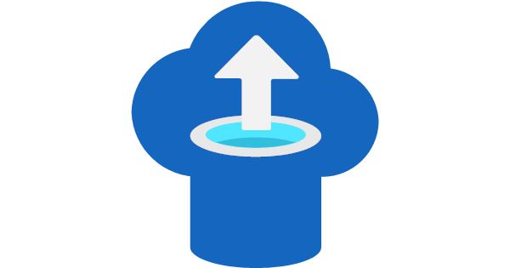
Azure Migration Tools
Data Migration
Assistant
Azure Data Studio
Azure Migrate
Lift and shift an entire VM
Discover SQL Servers across your enterprise
Assess SQL Server for the right migration targets
Get deployment recommendations
Estimate costs for migration
Application migration assessments
Free download tool
Assess SQL Server for possible migration blockers/warnings
Get deployment recommendations with SQLAssessment.exe
Automate through the command line
Cross-platform
Extension for Azure migration
Assess SQL Server for possible migration blockers/warnings
Offline or online migrations to Azure
Database
Migration Service
Log Replay
Service

Slide 22
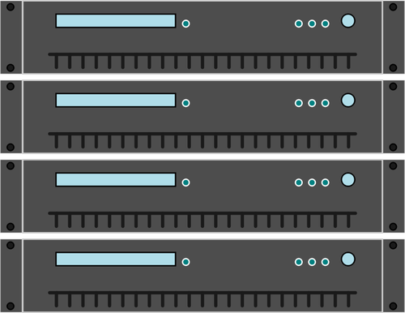
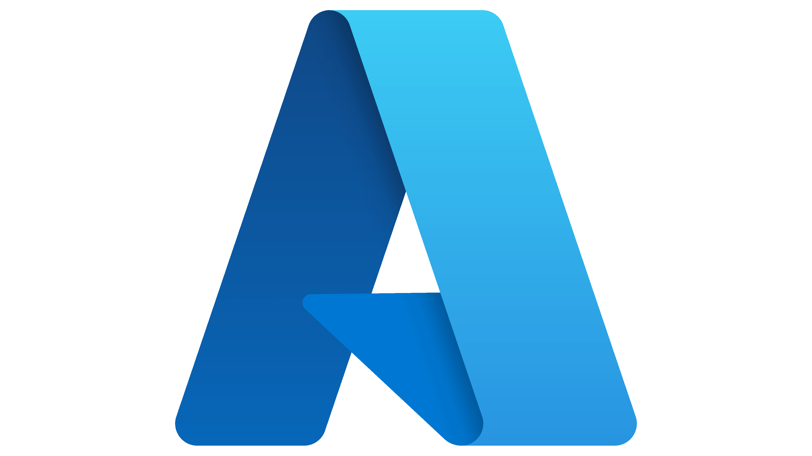


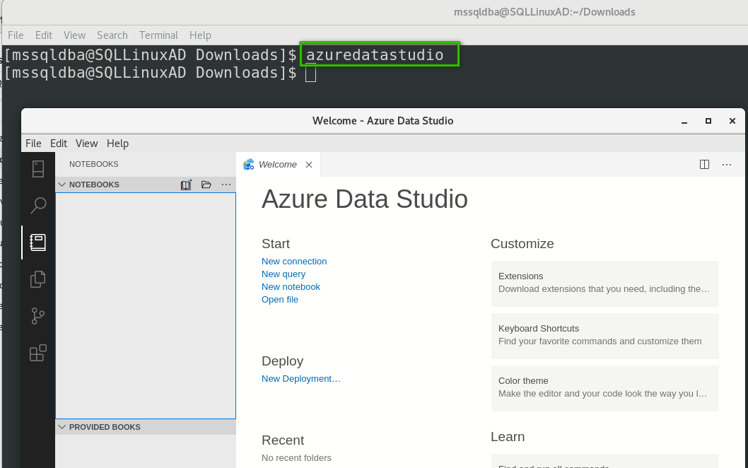

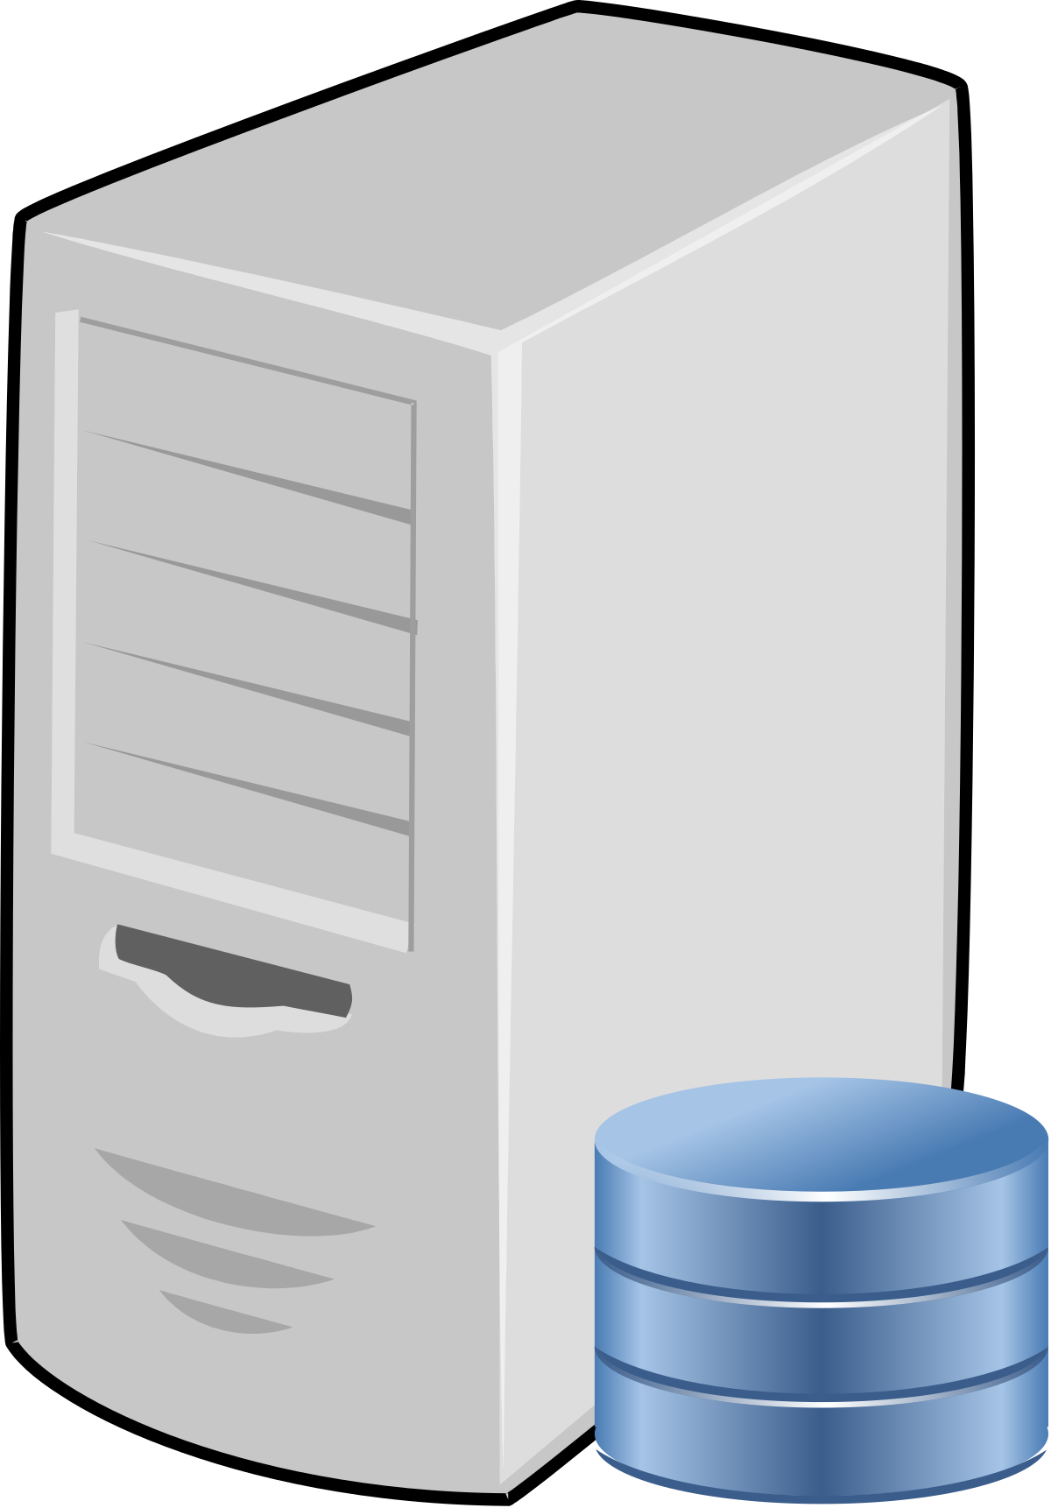
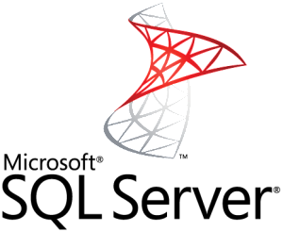


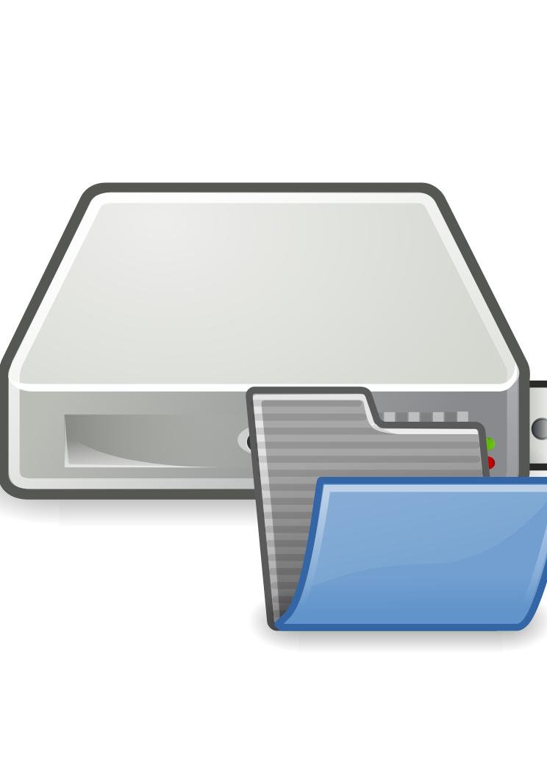
On-Premises
Customer Subscription
Azure
Azure Data Studio
(Azure SQL Migration Extension)
Azure Database Migration Service
DMS is associated with Self-hosted Integration Runtime and orchestrates migration activities to copy backup files to Azure storage after validation
Self-hosted Integration Runtime:
Download and install SHIR on local machine or on-premises server or Azure virtual machine with access to source database server and file share
Source SQL Server:
Source SQL Server database
Azure SQL:
Backup files are restored to the chosen Azure SQL targets:
Azure SQL MI (or)
SQL Server on Azure VM
Azure Storage Account:
Blob storage container to copy database backups into
SMB File Share:
Source database backup file's location for full and log backups

Slide 23



Customer Subscription
On-Premises / Azure VM
Azure
Azure Data Studio
(Azure SQL Migration Extension)
Azure SQL Managed Instance
Azure Database Migration Service
DMS is associated with Self-hosted Integration Runtime and orchestrates migration activities to copy backup files to Azure storage after validation
Log Replay Service
Self-hosted Integration Runtime:
Download and install SHIR on local machine or on-premises server or Azure virtual machine with access to source database server and file share
Managed Instance
Managed Database
Source SQL Server:
Source SQL Server database
Azure Storage Account:
Blob storage container to copy database backups into
SMB File Share:
Source database backup file's location for full and log backups
On-premises SQL Server
SQL Server on Azure VM
SQL Server on Azure VM

Slide 24
Customer Subscription
On-Premises / Azure VM
Azure
Azure Data Studio
(Azure SQL Migration Extension)
Log Replay Service
Log Replay Service is a cloud service that's enabled for Azure SQL Managed Instance and is based on SQL Server log-shipping technology to migrate databases.
Azure SQL Managed Instance
Azure Storage Account:
Blob storage container with database backups
Source SQL Server:
Source SQL Server database
Managed Instance
Managed Database
On-premises SQL Server
Azure Database Migration Service
DMS is associated with Self-hosted Integration Runtime and orchestrates migration activities to copy backup files to Azure storage after validation
SQL Server on Azure VM

Slide 25
SQL Server on Linux migrations
Migration options
Backup/Restore
Replication
Announcing migrations with Azure Data Studio
Availability Groups with External cluster type
Offline and online migrations
Require SHIR on windows client
Assessments coming soon!

Slide 26
Summary
Choose SQL Server in Azure Virtual Machine for fast migration and control of SQL Server versions
Azure SQL Managed instance is a fully managed instance using the power of SQL Server
Discover SQL Server instances across your enterprise with Azure Migrate
Assess and get deployment recommendations with our all our tools.
Execute online migrations with Azure Data Studio

Slide 27
Assess SQL Server
Module 2
Overview
Discover SQL Server
Assess SQL Server
Plan for Azure migration
Summary

Slide 28
Discover and Assess SQL Server to Migrate
Discover
Assess
Find your SQL Server instances
Get an inventory
Use Azure Migrate
Look at your requirements
Check for any blockers or warnings
Assess your workload
Look at deployment options
Estimate costs
Use the right tools
Analyze the results
Plan for migration

Slide 29
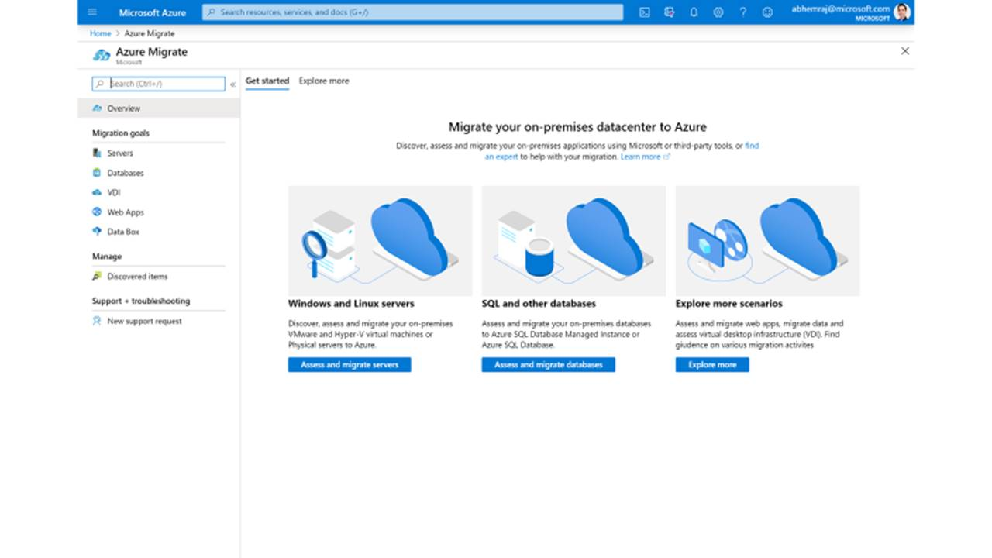
Azure Migrate: A Central Hub for Datacenter Migration
Assess and Migrate SQL Server
Assess your on-premises databases and receive a full report including the best-fit Azure SQL platform for your current environment
Multiple Scenarios
Migrate Windows and Linux Servers, Databases, Data, Web Applications and Virtual Desktops
Diverse Capabilities
Comprehensive discovery, assessment, and migration capabilities powered by Azure and third-party tools
Centralized Visibility
Centralized migration repository delivering end-to-end tracking and insights
Notes:
In the past, cloud migration was overwhelming with disconnected tools in different places.
That's why Microsoft introduced Azure Migrate to bring everything together and simplify cloud migration. With one centralized migration service, you can discover and assess your datacenter, and then migrate workloads to Azure.
Discover, assess, and migrate on-premises applications, infrastructure, and data. Centrally plan and track the migration across multiple Microsoft and independent software vendor (ISV) tools.
A comprehensive approach to migrating your application and datacenter estate. Supports key migration workloads like Windows Server, Linux, SQL and other Databases, data with Data Box, Web Applications, and Workstations (including Virtual Desktop Infrastructure). Holistic across VMware, Hyper-V, physical server, and cloud-to-cloud migration.

Slide 30
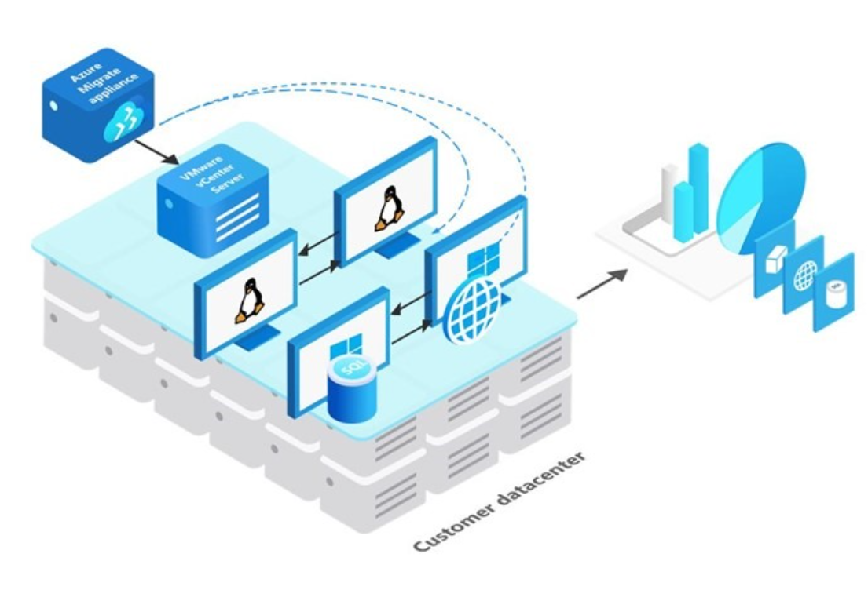
Assess SQL Servers on VMware for Azure readiness with Azure Migrate
Discover your SQL Server instances and databases running in a VMware environment
Analyze their configuration, performance, and application dependencies for migration to Azure SQL Database and Azure SQL Managed Instance
Assessments will include Azure SQL readiness, right-sizing, and cost projections
Learn more about here
Notes:
This is the process for assessing SQL server on VMware. If you would like to assess SQL server running on physical servers or other hypervisors, use Data Migration Assistant.
Moving on-premises infrastructure, databases, and applications to Azure is key to the success of your cloud migration and modernization journey, and we are committed to simplifying that process.
With each major milestone, we set out to make these primary migration scenarios as seamless as possible.
You can use Azure Migrate to create a unified view of your entire datacenter, across Windows Server, Linux, and SQL Server.

Slide 31
Demo Discover SQL Server using Azure Migrate
Notes:
Show video from Ignite

Slide 33
Assess SQL Server Migration
Analyze requirements
Blockers or Warnings?
Assess the workload
Evaluate the target
Analyze recommendations
Plan for migration

Slide 34
Basic migration - SQL Server 2016
Resource Requirements
Installed on Virtual machine with 16 vCores and 64Gb RAM
Database is ~50Gb data and ~2Gb transaction log
Data and log files are stored on the same drive
Desired storage growth is 1TB for data and 500Gb for transaction log
Tempdb split into 8 files on OS drive
Backups are stored on different storage
SQL Server 2016
Standalone instance Standard Edition on Windows Server 2016
Application is based on TPC-H
ISV application requires SQL Server 2016
Can afford downtime to migrate to Azure
SQL Server requirements
SQL logins for authentication
SQL Agent jobs for auto backups and update stats
Use Query Store and DMVs to monitor performance
Use SSMS to query and monitor SQL Server
DBAs desire access to the ERRORLOG for monitoring and troubleshooting purposes

Slide 35


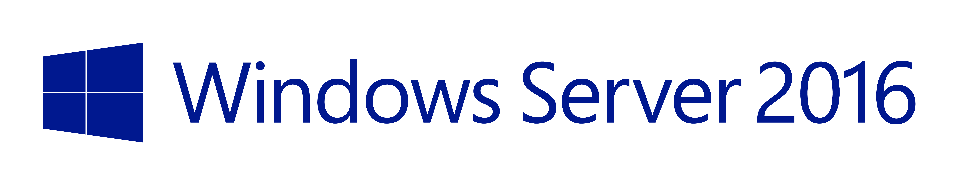
Assessing the basic migration scenario
SQL Server on Azure Virtual Machines
SQL Server 2016
Data Migration
Assistant
TPC-H
Review the results
ISV app locked to SQL Server 2016
Deploy SQL Server 2016 Standard Edition with Windows Server 2016
Azure Virtual Machine must be target
We can do an offline migration
Check blockers but unlikely
Run workload with SKU assessment – Target Azure VM
Azure VM size recommendations
I/O requirements
Merge with other requirements

Slide 36
Demo Assess a basic SQL Server migration
Notes:
Go through the readme.md in 02-Assess\basic

Slide 37
Advanced migration - SQL Server 2019
Resource Requirements
Installed on Virtual machine with 32 vCores and 256Gb RAM
Database is ~50Gb data and ~12Gb transaction log
Data and log files are stored on different drives
Desired storage growth is 1.5TB for data and 500Gb for tlog
Tempdb split into 12 files on separate storage
Backups are stored on different storage
SQL Server 2019
SQL Server Enterprise Edition running on Windows Server 2019 in a domain
Application based on TPC-C
Database deployed in an Availability Group with 1 sync secondary replica
ISV application will support PaaS
Need online migration
Desire benefits of Azure managed services
SQL Server requirements
Windows logins for authentication
SQL Agent jobs for auto backups, checkdb, and reorg indexes
Use Query Store and DMVs to monitor performance
Use SSMS to query and monitor SQL Server
Extended events sessions with file target
DBAs desire access to the ERRORLOG for monitoring and troubleshooting purposes
‘max degree of parallelism’ configured to 1 for OLTP
Desire to implement SQL Server Machine Learning Services

Slide 38
Assessing the advanced migration scenario
Data Migration
Assistant
Azure SQL Managed Instance
TPC-C
Review the results
We need to make sure no blockers
Run workload with SKU assessment – Target Azure SQL MI
Verify I/O latency
Service Tier and core recommendations
I/O requirements
Merge with other requirements
PaaS allowed and even desired
We need instance level features
We need equivalent of an Availability Group
We need an online migration

Slide 39
Demo Assess an advanced SQL Server migration
Notes:
Go through the readme.md in 02-Assess\advanced

Slide 40
Plan for migration to Azure Virtual Machine
Prepare for deployment decisions
Gain access to Azure to deploy an Azure Virtual Machine
Use the marketplace?
Decide region
Is VM size recommended appropriate?
What is the Windows admin account to use during?
How should we configure storage?
We have a standalone instance = no special HA requirements exist.
Connecting and validation
What other software or tools needed?
RDP access needed
Workload validation can happen within the VM
Need an Azure storage account to backup and restore the database (offline migration)
How will we migrate other objects?
What can we do optimize and manage after deployment?

Slide 41
Plan for migration to Azure SQL Managed Instance
Prepare for deployment decisions
Gain access to Azure to deploy an Azure SQL Managed Instance
Decide region
Verify service tier and vCore recommendations
We have an availability group = We must choose Business Critical service tier.
Memory might be a problem?
Public endpoint enabled?
Do we have to worry about storage?
What is the SQL Server admin account to use?
Connecting and validation
Connect from public or private endpoint
Client needs SSMS and workload client
Does Query Store and all the DMVs work?
Can I use sp_configure and CHECKDB?
How do we access the ERRORLOG?
Online migration
Azure storage to hold backups
Azure Data Studio with migration extension for online migration
How will we migrate other objects?
SQL Agent jobs
Windows domain logins
Extended Events file target
What can we do optimize and manage after deployment?
Do we need to configure tempdb files?
Save licensing costs
Security the managed instance
Use Azure services
Notes:
Memory might be a problem with the current BC “Standard” tier. But later we will find out new options for us.

Slide 42
Summary
Azure Migrate can discover and assess SQL Server
across your enterprise
Our tools can assess your workloads and provide
deployment recommendations
SQL Server version requirements can lead to migrations
for SQL Server in Azure Virtual Machines
Azure SQL Managed Instance supports instance level
features and built-in high availability
Analyze assessments to plan for migration

Slide 43
Migrate SQL Server to Azure Virtual Machine
Module 3
Overview
Deploy SQL in Azure Virtual Machine
Offline database migration
Online database migration
Migrate other objects
Customer stories and Summary

Slide 44
Migrate SQL Server to Azure Virtual Machine
Deploy
Migrate
Review the assessment and plan
Deploy a virtual machine in Azure
Perform an offline migration to Azure VM
Perform and online migration to Azure VM
Migrate other objects

Slide 45
Review the assessment and plan
Deploy an Azure Virtual Machine
Use the Azure portal and marketplace
Connect and verify SQL installation
Perform an offline migration
Create an Azure storage account
Restore from Azure storage to Azure VM
Migrate SQL logins
Migrate SQL Agent jobs
Choices based on assessment and plan
Deploy the VM
Full backup to Azure storage from source instance
Azure templates for automation
https://aka.ms/azuretemplates

Slide 46



Deploy SQL Server in Azure Virtual Machine
Use the marketplace to choose SQL Server 2016 Standard Edition
New resource group, VM name, appropriate region, and VM size
aka.ms/SQLIaaSSizing
Admin account, inbound RDP port, and Windows licensing
Review and set VM networking and management options
Review and set SQL Server settings – Optimize while you deploy with storage settings
Deploy!
New portal experience coming!

Slide 47
Demo Deploy SQL Server in Azure Virtual Machine
Notes:
Follow the readme.md file in 03-MigrateToAzureVM\deploy

Slide 48







Offline database migration to Azure Virtual Machine
RDP, AzCopy, Azure Data Explorer
BACKUP TO URL
RESTORE FROM URL
SQL Server
SQL Server
RESTORE
RECOVER
BACKUP
Azure Data
Studio
Self-hosted
Integration runtime
Database
Migration Service
Lift and shift VMs
with Azure Migrate
Notes:
Bob

Slide 49
Demo Offline database migration to Azure Virtual Machine
Notes:
Follow the readme.md file in 03-MigrateToAzureVM\offlinemigrate

Slide 51

Online database migration to Azure Virtual Machine
Log Shipping, Replication, AG replica
SQL Server
SQL Server
RESTORE
BACKUP
FINAL RESTORE
RECOVERY
CUTOVER
Self-hosted
Integration runtime
Azure Data
Studio
Database
Migration Service
Failover with
Azure Site Recovery

Slide 52
Migrate other objects
Logins and Roles
Linked Servers
External Data Sources
Agent Jobs, Alerts, and Mail
Replication
Other instance objects

Slide 53


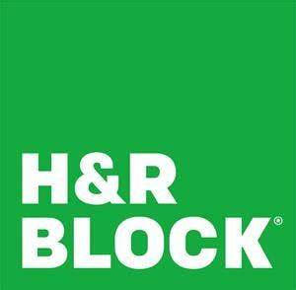
Customer stories
Microsoft Customer Story-GEICO finds that the cloud is the best policy after seamless modernization and migration
Microsoft Customer Story-E-commerce leader migrates to SQL Server and Azure SQL Database, boosts product performance, opens markets
Microsoft Customer Story-H&R Block delivers scalable, multichannel tax preparation services with Microsoft SQL Server 2017

Slide 54
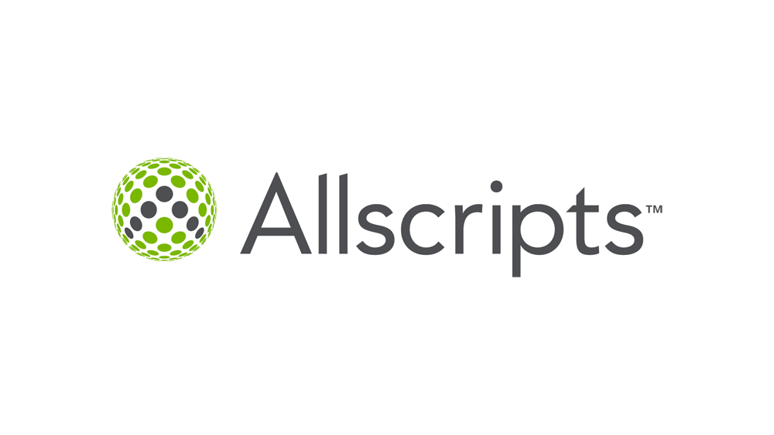
The Allscripts prescription for agility: lift and shift to the cloud
“…In just three weeks, the company lifted and shifted dozens of acquired applications running on 1,000 virtual machines to Azure…”
Microsoft provides Allscripts with a Health Insurance Portability and Accountability Act (HIPAA) Business Associate Agreement
For systems that could not be migrated to Azure, Allscripts moved them to an Allscripts datacenter and set up a VPN between that datacenter and the Azure datacenter in hybrid fashion
For these, Allscripts took advantage of the Azure Hybrid Benefit, an offer that lets customers reuse their existing on-premises Windows Server and SQL Server licenses in Azure and realize licensing savings of up to 82 percent
The team further used services such as Azure Application Insights, Azure Log Analytics, Azure Monitor, and Azure Security Center to create a sophisticated monitoring and alerting tool for RTBI. The cost to use all these services? About $15 a day.
Notes:
Beyond the 1,000 acquired VMs that Allscripts quickly migrated to Azure, the company is using a similar strategy to migrate another estimated 5,000 to 6,000 VMs to Azure over the next couple of years. “By migrating workloads to Azure, we’ve already closed or moved three of our datacenters, one of which was in Singapore,” Tomlinson says. “It’s much easier for us to manage systems in Azure than hardware in a datacenter half a world away.”

Slide 55
Summary
Review your assessment and migration plan
Easily deploy Azure Virtual Machine using the portal or automation
Perform an offline migration using backup/restore or Azure Data Studio
Perform an online migration with Azure Data Studio
Migrate other objects using scripting and copy
Notes:
Ajay and Bob is what is next

Slide 56
Optimize and manage SQL Server in Azure Virtual Machine
Module 4
Overview
Using the SQL IaaS Agent extension
Implement best practices
Setup and configure HADR
Verify your workload and application
Use the power of Azure
Summary

Slide 57
Optimize and manage SQL Server in Azure Virtual Machine
Best Practices
Use the power of Azure
Using the SQL IaaS Agent extension
Security, storage, and networking
SQL Server best practices
Configure HADR
Verify workload and application
Microsoft Defender for SQL
SQL Assessment
SQL Insights
Azure Purview integration
https://aka.ms/azuresqlvmbestpractices
Notes:
Note that SQL Server best practices actually follow all of the ones you know and love. There is nothing here specific to Azure VM.
Azure Purview integration exists today and will even go further in the future. Just reference here and future versions of the workshop will have more details.

Slide 58
Using the SQL IaaS Agent extension
What is it?
How do I use it?
What are the benefits?
Azure portal management
Automatic Updates
Azure Hybrid Benefit (AHB)
Recommendations in the portal
Full
Lightweight
Built-in from the marketplace
NoAgent
Register: single or in bulk
Modes
An Azure virtual machine extension to automate management and administrative tasks
Automatic Backups
Azure Key Vault integration

Slide 59
Demo Explore Azure and the SQL IaaS Agent extension

Slide 60




Secure SQL Server in Azure Virtual Machine
Secure RDP (or SSH) port access
Disable the SQL Server port or use non-standard port
Apply updates and enable automatic updates
Use Azure Key Vault for keys for encryption
Managed disks encryption options
Azure Active Directory Authentication
SQL Ledger
SQL Server 2022
Private Preview

Slide 61





Optimizing storage
Look at the exact set of tips
Choose the right type
Premium = Production
Standard = Dev/Test
Ultra = Extreme low latency
Choose the right VM size to avoid any disk capping/throttling
Choose the right size
Premium P30+ for data to ensure caching available
Premium P30+ depending on cost and throughput requirements
Ultra = Extreme low latency
M-series offers Write Accelerator over Ultra
Ebdsv5-series
M-series
Highest memory and vCores available in Azure
Once generally available, will offer best price-performance for SQL Server workloads
Edsv5-series
Best all-purpose SQL Server virtual machine
PREVIEW
Placement
Data files on separate drive with read cache enabled
Tlog files on separate drive with no cache enabled
Tempdb on local SSD drive
Other Tips
Disable geo-redundant storage and use local redundant storage
Consider using Storage Spaces if you need to increase I/O bandwidth

Slide 62
Don’t forget about SQL Server
Locked pages in memory
Instant File Initialization
Multiple tempdb files
SQL Assessment may help

Slide 63

Backup/restore
Full matrix here
 | Automated Backup | Azure Backup | Manual Backup
Point-in-time restore
Automatic
Manage multiple VMs
Backup to Azure Storage
Backup to attached disk
Long-term backup retention
Customize all options

Slide 64


Backup storage options explained
VM Managed disk
Azure Blob Storage
Azure Premium File Share
BACKUP to DISK
Requires you to manage the disk
VMs limit number of attached disks
Pay whether using it or not
Disks are encrypted
All T-SQL BACKUP options available
Large capacity (up to max disks for VM)
Takes up capacity/bandwidth for VM
Hard to access if VM not available
BACKUP to URL
Requires to create storage account
Doesn’t require access to VM
Storage is encrypted
Not all T-SQL BACKUP options are available
Billed separately
Maximum size = 12TB
Accessible if VM not available
Setup yourself to migrate to PaaS
BACKUP to DISK
Requires to create storage account
Doesn’t require access to VM
Storage is encrypted
ALL T-SQL BACKUP options are available
Billed separately
Maximum size = 100TB
Accessible if VM not available
SMB Multichannel to accelerate performance

Slide 65
Demo Backups in Azure Virtual Machine

Slide 66

Failover Cluster instances in Azure Virtual Machines
Lift and shift
Windows Server Failover Cluster (WSFC) and SQL Server
Availability Sets and Zones
Azure Shared Disks, Premium File Shares, Storage Spaces Direct
Disk Witness, File share witness, and Cloud witness
Distributed Network Name
Azure Load Balancer

Slide 67
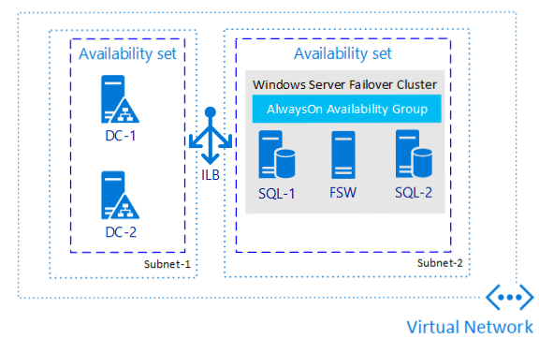
Always On Availability Groups
Lift and shift

Slide 68
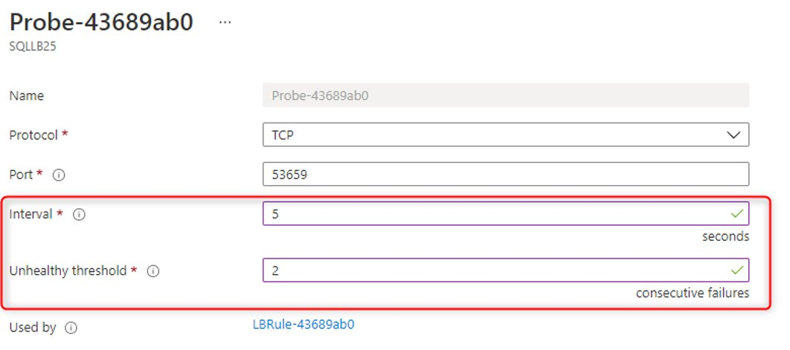
High Availability requirements for SQL Server VMs
AG Listener and SQL FCI requires an Azure Load Balancer
Each region requires a load balancer
AG Listener name SQL FCI network names requires an IP that can “float” across replicas/nodes
Distributed Network Name (DNN) has limitations
Failover/failback is not instance – takes at least 10 seconds

Slide 69
Multi subnet Zone Redundant FCI - HA scenario

Slide 70
Multi subnet AG - HA scenario
Notes:
Eliminates need for Azure Load Balancer
Faster failover (no external probe latency)
SQL Server natively supports multi subnet​
No restriction on SQL Server version​ or Windows version​
All SQL Server features work right out of the box​

Slide 71
Demo New experiences for availability in Azure Virtual Machine

Slide 72
Verify your application
Setup connectivity to virtual network
Azure virtual network name resolution
Verifying performance
Don’t forget about any tools or scripts to manage
Retry logic?

Slide 73
Demo Verify your workload

Slide 74
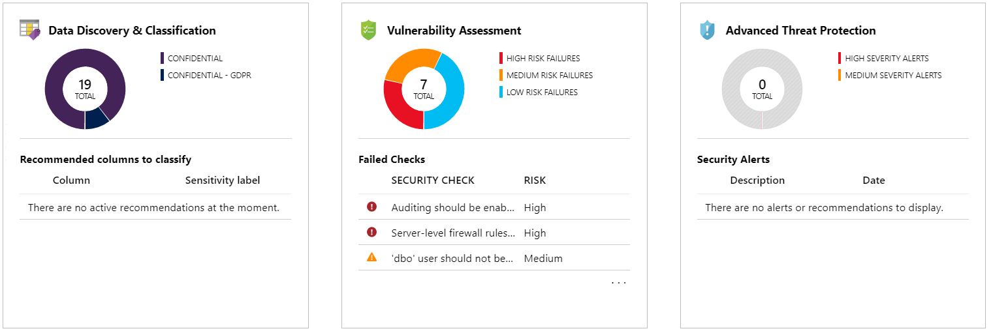
Setup Microsoft Defender for SQL
Microsoft Defender for Cloud
Works across all SQL
Enable at subscription or resource
Scan based on frequency
SQL injection attacks
Based on industry standards
Brute force attacks
Rules refreshed
Suspicious activity
Baselines and insights
Alerts

Slide 75
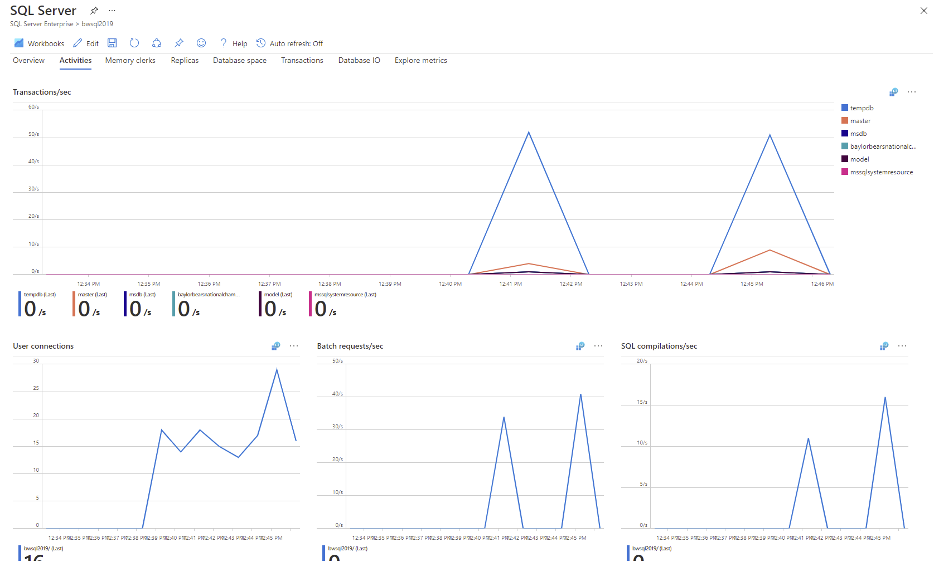
Setup SQL Insights
aka.ms/azuresqlinsights
PREVIEW
“perfmon” for the cloud
Monitoring VM
SQL collections
Works across Azure SQL
Log Analytics

Slide 76
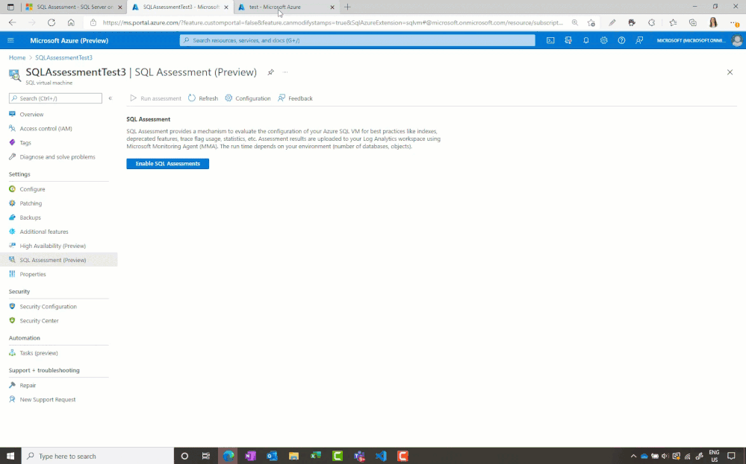
Setup SQL Assessment
PREVIEW
aka.ms/sqlassessmentvm
Assess for best practices
Rich ruleset
SQL Assessment API
Log Analytics Workspace
Dashboards and trends
Schedule or on-demand
Notes:
Ajay
In this demo, we're going to look at the SQL assessment for SQL Server on Azure Virtual machines,
which is currently in preview.
This service helps you keep your VM healthy by evaluating it using configuration best practices.
Other highlights of the service include the ability to schedule or run the assessment checks on demand,
and see the results. In Azure Portal it comes with a rich ruleset which is published on GitHub with SQL Server as well as SQL Server on Azure VM.
You need to install the SQL IaaS agent extension in full mode to leverage this capability for SQL Server 2012 or higher versions.
And finally the assessment results are stored in your own log analytics workspace so that we have historical information available
for you at any time.

Slide 77
Demo Using the power of Azure
Notes:
Demo Microsoft Defender, SQL Assessment, and SQL Insights

Slide 78
Summary
Take advantage of the SQL IaaS Agent extension
Implement our best practices
Setup and configure HADR per your requirements
Verify your workload and application
Use Azure services such as Defender, SQL Assessment, and SQL Insights

Slide 79
Migrate to Azure SQL Managed Instance
Module 5
Overview
Deploy Azure SQL Managed Instance
Offline database migration
Online database migration
Migrate other objects
Customer stories
Summary

Slide 80
Migrate SQL Server to Azure SQL Managed Instance
Deploy
Migrate
Review the assessment and plan
Deploy Azure SQL Managed Instance
Perform an offline migration to Azure SQL Managed Instance
Perform and online migration to Azure SQL Managed Instance
Migrate other objects

Slide 81
Review the assessment and plan
Deploy an Azure SQL Managed Instance
Use the Azure portal and marketplace
Connect and verify installation
Perform an online migration
Create an Azure storage account
Migrate Windows logins
Migrate SQL Agent jobs
Choices based on assessment and plan
Deploy the Instance
Full backup to Azure storage from source instance
Migrate Extended Events
Reconfigure maxdop
Continuous log backups and cutover
Azure templates for automation
https://aka.ms/azuretemplates

Slide 82
Deploy Azure SQL Managed Instance
Use the marketplace to choose Azure SQL Managed Instance
New resource group, instance name, and appropriate region
Service tier and resource choices
Admin account
Choose network settings
Review additional settings
Deploy!

Slide 83
Demo Deploy Azure SQL Managed Instance

Slide 84
Offline database migration to Azure SQL Managed Instance
BACKUP TO URL
RESTORE FROM URL
SQL Server
RESTORE
RECOVER
BACKUP
Azure Data
Studio
Self-hosted
Integration runtime
Database
Migration Service

Slide 85
Online database migration to Azure SQL Managed Instance
Replication, Log Replay Service
SQL Server
RESTORE
Log Replay Service
BACKUP
FINAL RESTORE
RECOVERY
CUTOVER
Self-hosted
Integration runtime
Azure Data
Studio
Database
Migration Service

Slide 86
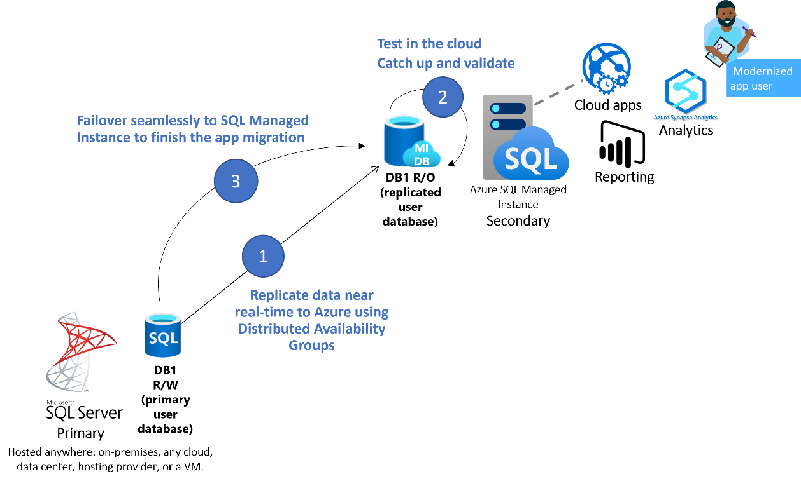
Link feature for Managed Instance for Migration
PREVIEW
Use AG technology
DB is accessible for read before cutover
Notes:
Bob
Two big differences with LRS
Uses DAG
Db accessible in MI

Slide 87
Demo Online migration to Azure SQL Managed Instance

Slide 89
Migrate other objects
Windows Logins to AAD
Linked Servers
Replication
Other instance objects
Agent Jobs, Alerts, and Mail
Logins and Roles
Objects requiring file system access (Extended Events)
SSIS packages

Slide 90



Customer stories
Microsoft Customer Story-City National Rochdale takes wealth management to the next level on Azure
Microsoft Customer Story-Komatsu achieves breakthrough performance gains and savings with Azure SQL Database Managed Instance
Microsoft Customer Story-AIA Singapore Private Limited drives performance enhancements and achieves more cost efficiencies after moving critical Java applications to Azure

Slide 91


Customer: MCS
Industry: Health Provider
Size: 1,000–9,999 employees
Country: Puerto Rico
Products and services: Microsoft Azure
Azure Data Factory
Azure SQL Managed Instance Microsoft Power BI
Read full story here
“We used Azure to meet our business goals for a more flexible database, more operational efficiency, and improved ability to deliver the healthcare information our customers need as quickly as they deserve.”
—Sigfredo García Irizarry, Assistant Executive Vice President of IT Administration, MCS
Healthcare company MCS manages a lot of data but found it time consuming, cumbersome, and expensive to replicate tables from its AS/400 system to its legacy cloud. MCS also wanted more support and expertise to guide solution best practices.
MCS adopted Microsoft Azure Data Factory to quickly replicate data. The company uses Azure SQL Managed Instance for database capabilities and for analytics, along with dashboards in Power BI.
Now, MCS replicates data easily and has minimized IT maintenance and improved decision making with better analytics. It gained peace of mind from receiving strong technical support from Microsoft along with expertise on how to optimize services for its customers.
Notes:
MCS set out to change its environment to get more out of its database, minimize IT maintenance, and gain more technical support. Attracted by the selection and interoperability of Microsoft Azure services, the company adopted Azure Data Factory, a data integration solution, to replicate data from the AS/400. It added Azure SQL Managed Instance as an operational database and for reporting and data analytics. MCS now conducts live replication of the AS/400 tables in its production environment and connects that data to SQL Managed Instance for a modern, cloud-based database experience with minimal IT burden.

Slide 92
Deploy an Azure SQL Managed Instance
Look at offline migration strategies and tools
Leverage online migration to reduce downtime
Learn how to migrate other instance objects
Summary

Slide 93
Optimize and manage Azure SQL Managed Instance
Module 6
Overview
Explore Azure SQL Managed Instance
Implement best practices
Verify application
Configure HADR
Use the power of Azure
Summary

Slide 94
Optimize and manage Azure SQL Managed Instance
Verify
The Power of PaaS
Explore Azure SQL Managed Instance
SQL configuration and admin tasks
Implement best practices
Verify workload and application
Configure HADR
Microsoft Defender for Cloud
SQL Insights

Slide 95
Explore Azure SQL Managed Instance
Explore the Azure portal
What CLI options do I have?
Is it the same T-SQL?
aka.ms/azuretsqldiff

Slide 96
SQL Configuration and admin tasks
SQL Configuration
Tempdb
Admin tasks
Query Store
System health
sp_configure
Trace flags
DMVs
Extended Events
Dbcompat
DBCC CHECKDB

Slide 97
Demo Explore Azure SQL Managed Instance

Slide 98



Implement best practices
Azure Hybrid Benefit (AHB)
Customize maintenance window
Secure Azure SQL Managed Instance
Monitoring service and resource health

Slide 99
Secure Azure SQL Managed Instance
Disable public endpoint
Azure Role-Based Access Control (RBAC) policies
Use minimum TLS
Consider AAD only
Configure storage endpoint policy
Use managed identities for Azure applications
Setup SQL Server Audit
Evaluate TDE with BYOK

Slide 100
Demo Best practices for Azure SQL Managed Instance

Slide 101
Verify workload and application
Verify workload
Application considerations
Use Windows auth to reduce authentication changes
Ensure correct service tier and vCores
Modify server names to instance URL
Same client connectivity as original workload test?
Was your source SQL Server using sync replicas?
PREVIEW

Slide 102
Demo Verify workload

Slide 103

Configure HADR
Disaster Recovery
Customize backup retention
Use COPY_ONLY backups
Backup billing
High-Availability
Review the SLA
Test a failover
Setup a read-only connection for Business Critical
Setup an auto-failover group

Slide 104
Demo Built-in HADR for Azure SQL Managed Instance

Slide 105
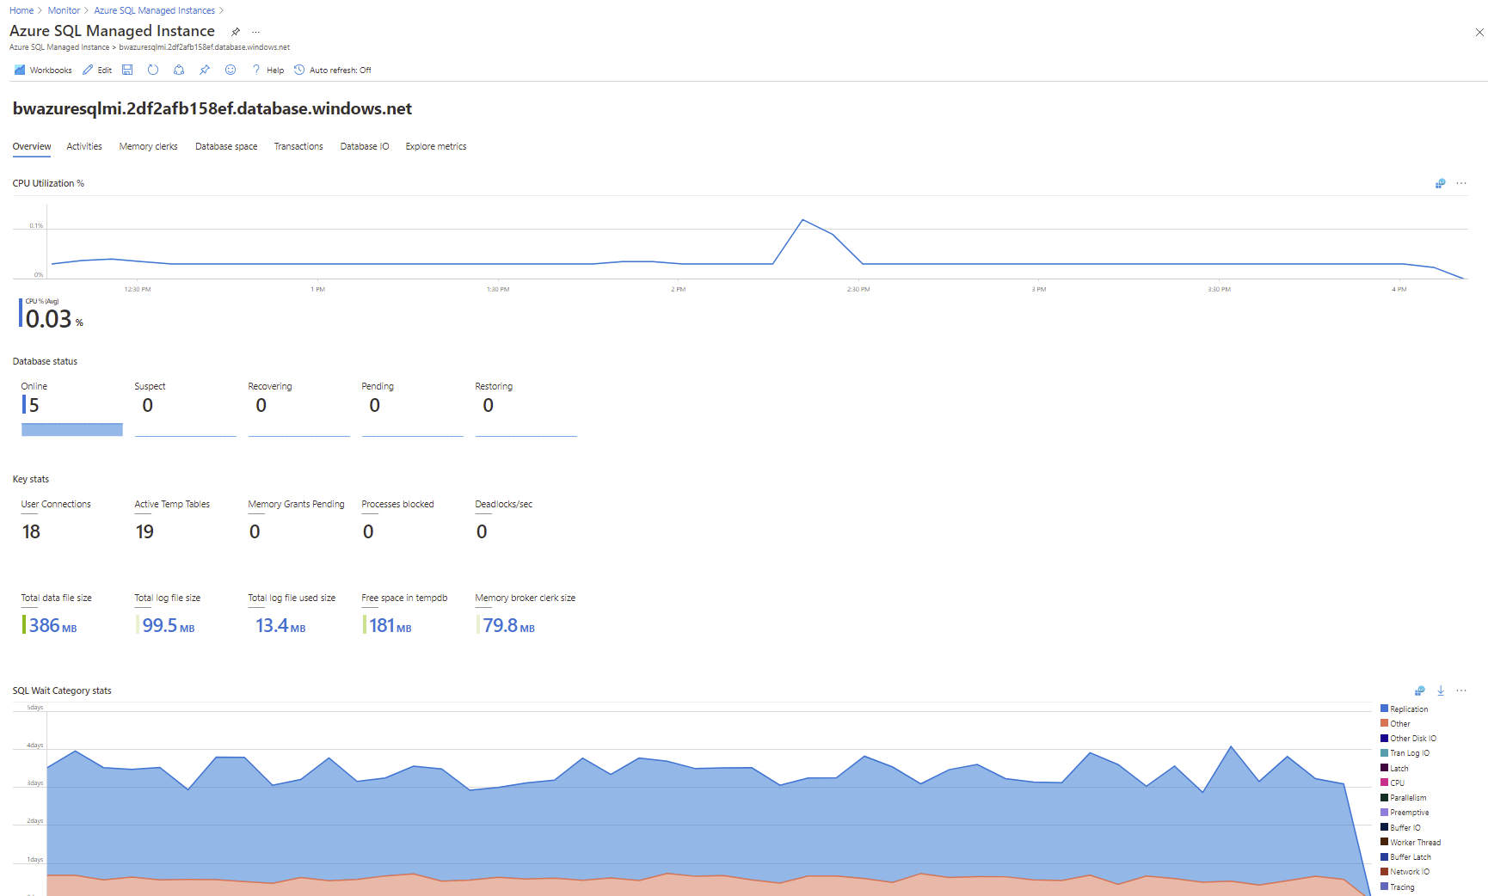
Use the power of Azure

Slide 106
Demo Microsoft Defender and SQL Insights

Slide 107
Explore Azure and verify SQL configuration and admin tasks
Implement best practices for licensing, security, maintenance, monitoring
Verify your workload and application
Configure PaaS HADR
Use the power of Azure
Summary

Slide 108
Migrate Azure SQL Virtual Machine to Managed Instance
Module 7
Overview
Assess
Migrate
Optimize
Summary

Slide 109
Migrate from Azure Virtual Machine to Azure SQL Managed Instance
Assess and Migrate
Optimize and manage
Assess and plan
Deploy Azure SQL Managed Instance
Offline or online migration
Migrate other objects
Explore Azure SQL Managed Instance
SQL configuration and admin tasks
Implement best practices
Verify workload and application
Configure HADR
Microsoft Defender for Cloud
SQL Insights

Slide 110
Basic migration - SQL Server 2016
Resource Requirements
Installed on Virtual machine with 16 vCores and 64Gb RAM
Database is ~50Gb data and ~2Gb transaction log
Data and log files are stored on the same drive
Desired storage growth is 1TB for data and 500Gb for transaction log
Tempdb split into 8 files on OS drive
Backups are stored on different storage
SQL Server 2016
Standalone instance Standard Edition on Windows Server 2016
Application is based on TPC-H
ISV application requires SQL Server 2016
Can afford downtime to migrate to Azure
SQL Server requirements
SQL logins for authentication
SQL Agent jobs for auto backups and update stats
Use Query Store and DMVs to monitor performance
Use SSMS to query and monitor SQL Server
DBAs desire access to the ERRORLOG for monitoring and troubleshooting purposes

Slide 111
Assess the migration
ISV will support application on PaaS if you keep dbcompat = 130
Standalone instance = General Purpose
No obvious blockers or warnings
PaaS = remove burdens + gain capabilities
Ensure all T-SQL differences are reviewed
Storage placement abstracted
Versionless SQL Server and all other updates automatic with maintenance windows
Review vCore recommendations
Ensure resource limits meet requirements
Automatic backups on separate storage with redundancy on retention customization
Built-in HA using shared storage with built-in connection abstraction
SLA
Prep for migration
Backups are already in Azure storage
Deploy Azure SQL Managed Instance
Consider “upgrading” HA to Business Critical?

Slide 112
Online migration from IaaS to PaaS
Existing full
Database backup
SQL Server
RESTORE
Log Replay Service
BACKUP LOG
CUTOVER
FINAL RESTORE
RECOVERY
Azure Data
Studio
Database
Migration Service

Slide 113
Demo Migrate online from IaaS to PaaS
Notes:
Bob - recorded

Slide 115
Optimize the migration
Explore Azure SQL Managed Instance
Implement best practices
Verify application
Configure HADR
Use the power of Azure

Slide 116


Migration futures
Azure Migrate is your one stop shop for the migration lifecycle
Azure Data Studio will be the signature tool for SQL Server migrations with automation
Include more business and financial insights into our tooling to assist decision making

Slide 117
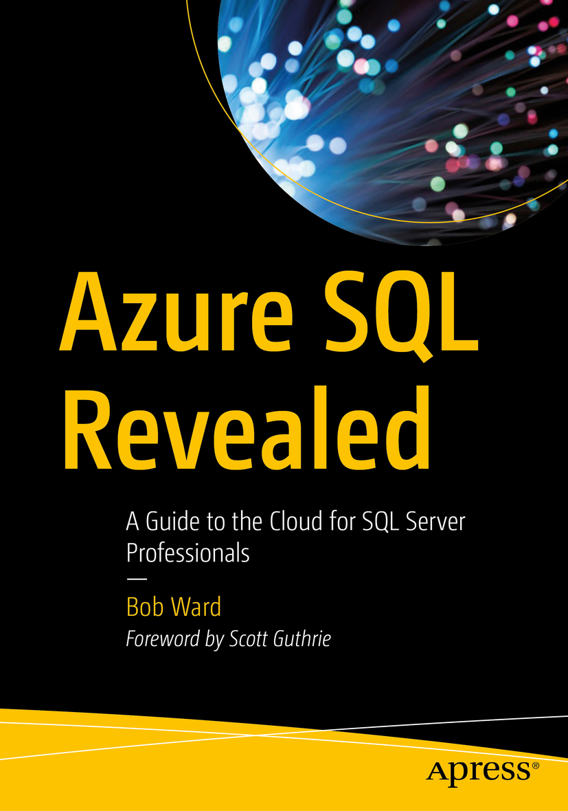
Resources
Microsoft Learn: Azure SQL fundamentals learning path
aka.ms/azuresqlfundamentals
Select the Azure SQL Workshop
aka.ms/sqlworkshops
How to choose tool
aka.ms/chooseazuresql
Azure SQL documentation
aka.ms/azuresqldocs
More videos from our team
aka.ms/azuresql4beginners
aka.ms/dataexposed
aka.ms/azuresqlbook

Slide 118
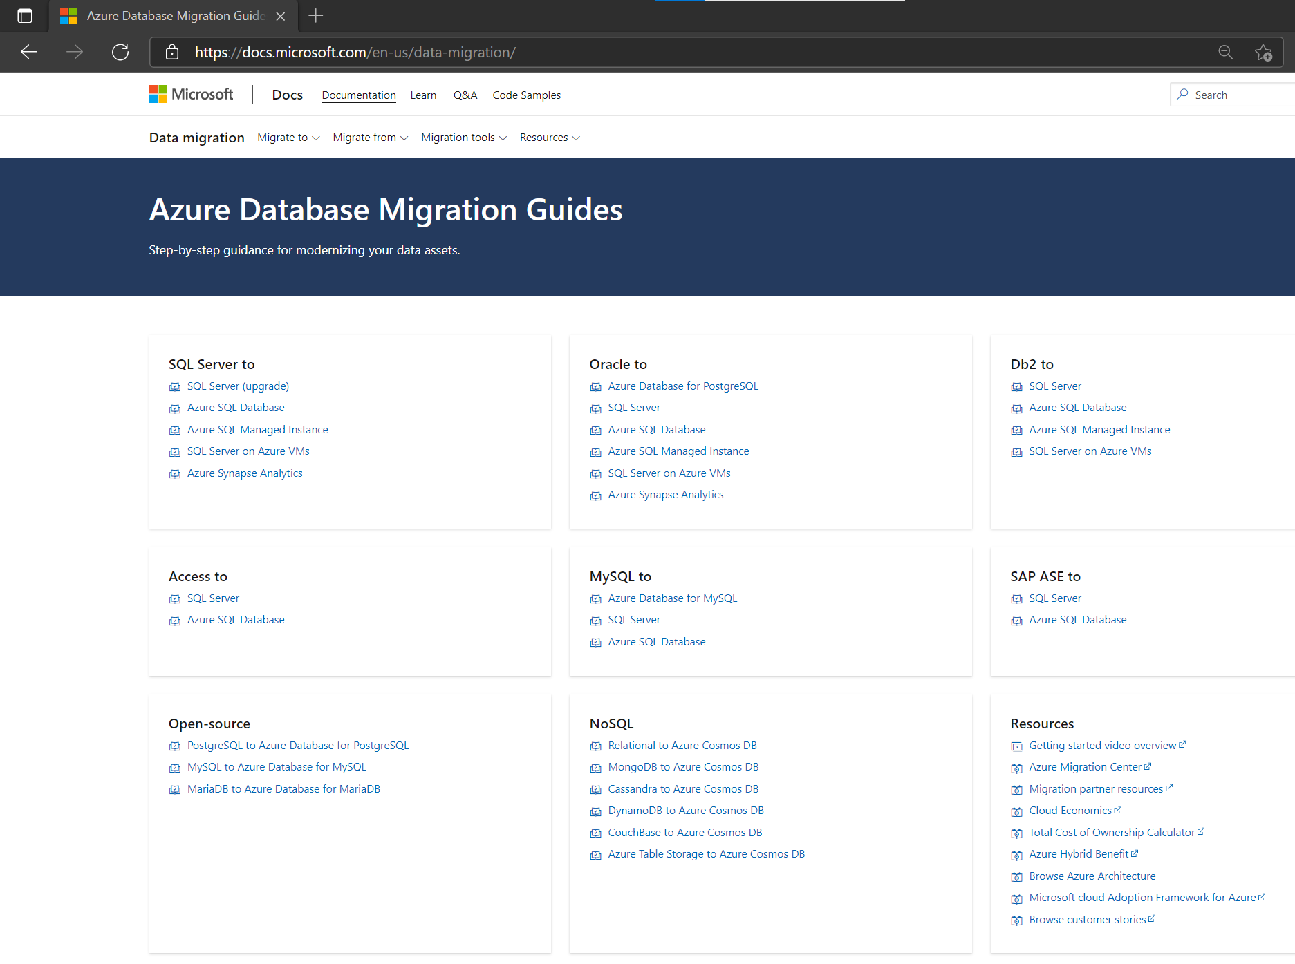
Azure Database Migration Guides
aka.ms/datamigration
Step-by-step guidance for modernizing your data assets
These guides gives step-by-step guidance and resources on migrating:
Any SQL Server 2005 version or newer to Azure
SQL Server on Virtual Machines, Amazon Web Services (AWS) EC2, Compute Engine (GCP), and AWS RDS
Your current databases, applications, and SQL Server logins
Learn more about Azure Database Migration Guides
Notes:
Find Step-by-step guidance and extensive documentation for modernizing your data assets.
We have several migration guides if you would like to migrate by yourself. If you want to migrate your own data you can do it by following these step-by-step guidance and instructions for all different sources and targets, for example, these can help you to move your SQL server to VM, etc.

Slide 119
Additional Resources
Main resources
Azure migration center
Azure Database Migration Guide
Find a partner
Azure Database Migration Service (DMS)
Azure DMS documentation
Azure Migrate
Azure Data Studio
Azure SQL Migration extension
Demos
Migrating and modernizing your data estate to Azure with Data Migration Services
Database migration roadmap with Microsoft
Blog
Data Migration Team Blog
Azure Data Studio Migration blog
Web pages
Azure SQL family webpage
3rd party studies
GigaOM price-performance study
Forrester Consulting Total Economic Impact™ study
Resources - infographics
Azure SQL family
Forrester Consulting Total Economic Impact™ study
Azure SQL Database serverless
Web App Migration Datasheet
SQL Server Cloud Pathways

Slide 120
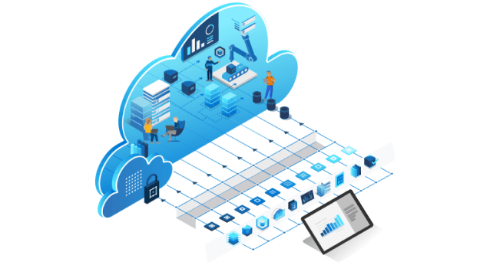


Azure Migration and Modernization Program (AMP)
aka.ms/azureamp
Self-guided digital
Guided deployments
Available for anyone
Access to digital resources
Guidance from Azure specialists
Expert guided help from partners or FastTrack for Azure engineers
Project assistance
Technical training tailored to you needs
Minimum project size to qualify
Notes:
Have an identified project supported by FastTrack for Azure that’s expected to reach at least an incremental $5,000 of service usage per month within 12 months of the FastTrack for Azure engagement.

Slide 121
sqlservervm@microsoft.com
dmsfeedback@microsoft.com
Install the free migration tools
Run Azure Migrate for discovery/assessment of your SQL estate
Understand readiness of your databases/apps for Azure
Use feedback in our tools to contact us
Pick a workload to migrate
Start small
Decide what to use based on Azure Migrate assessments
Do a proof of concept
Use DMA for SKU recommendation
Deploy your VM/Managed Instance per recommended best practices
Use Azure Data Studio to migrate your databases to Azure
Call to action

Slide 122
Thank you!

